Slide 1
Inženjerstvo softvera za Internet-Web of Things
Multimedia streaming

Slide 2
Multimedia streaming
Osnovna upotreba je u IP kamerama
Raspberry Pi ima svoj modul za kameru, ali može da koristi i USB webcams
Logitech sigurno radi
ESP32 ima posebnu hardversku konfiguraciju sa integrisanom kamerom
Slabija rezolucija i frame rate
Mi ćemo se fokusirati na Raspberry Pi
Najjednostavniji format je MJPEG

Slide 3
MJPEG format
Motion JPEG
Tok pojedinačnih JPEG slika (intraframe-only kompresija)
Mana je da nema računanja razlike između dva frejma, pa da se šalje samo ta razlika
Stepen kompresije je 1:20 naspram 1:50, kada imamo računanje razlike
Prednost je da nije komplikovano kodiranje i dekodiranje
Najrasprostranjenija upotreba ovog formata je u MJPEG HTTP Streaming

Slide 4
MJPEG HTTP streaming
Ideja je da veb server vraća u zaglavlju HTTP odgovora sledeći Content-type:
Content-Type: multipart/x-mixed-replace;boundary=image-boundary
To znači da u telu odgovora imamo boundary string, pa onda minijaturno zaglavlje, pa onda sliku, i tako neprekidno:
--image-boundary
Content-Type: image/jpeg
Content-Length: 23520
X-Timestamp: 2253.066890
<SLIKA>
--image-boundary
Content-Type: image/jpeg
Content-Length: 23457
X-Timestamp: 2253.166890
<SLIKA>
Kako znamo gde počinje slika?
JPEG slika počinje bajtom 0xFF

Slide 5
MJPEG streaming na Raspberry Pi
Dve varijante:
Standalone aplikacija
https://github.com/jacksonliam/mjpg-streamer
ili
ffmpeg i ffserver kombinacija
Python mjpeg-streamer modul
pip install mjpeg-streamer

Slide 6
mjpeg-streamer build kao standalone aplikacija
Skine se izvorni kod sa github repozitorijuma
Instaliraju se sve zavisnosti i kompajleri
sudo apt install cmake libjpeg-dev gcc g++
make
# opciono: make install
Dobijamo program koji pozivamo ovako:
export LD_LIBRARY_PATH="$(pwd)"
./mjpg_streamer -i "./input_uvc.so" -o "./output_http.so -w ./www"
MJPEG stream je dostupan na adresi:
http://racunar:8080/?action=stream

Slide 7
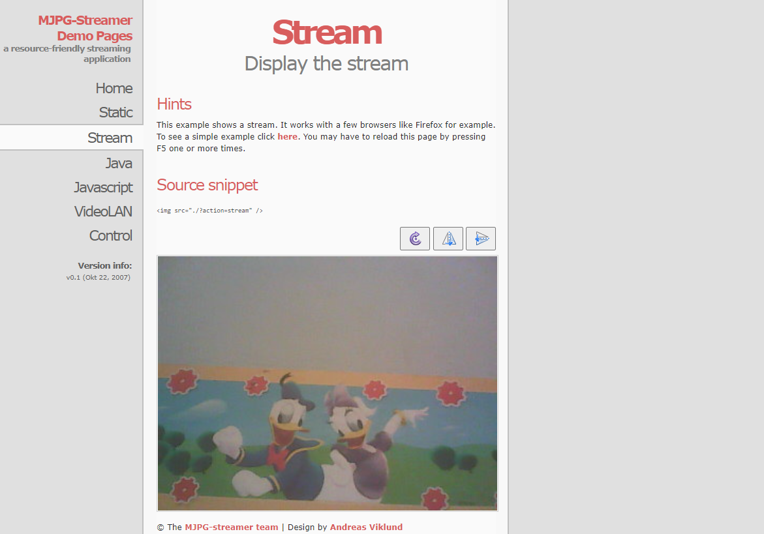
http://racunar:8080/?action=stream

Slide 8
ffmpeg i ffserver programi
Programski paket za obradu audia i videa
Transcoding, concatenation, trimming, scaling,...
Od 2018. ffserver je izbačen iz ffmpeg projekta
Poslednja verzija sa njime je 3.4 – dostupno kao 3.4.13 u 2023. godini
ffserver služi za strimovanje sadržaja preko weba
ffserver -f /etc/ffserver.conf
ffmpeg spaja ulaz (video kameru) i web server:
ffmpeg -f video4linux2 -s 320x240 -r 15 -i /dev/video0 http://localhost:8080/camera.ffm
Streaming dostupan preko:
http://localhost:8080/camera.mpeg

Slide 9
ffserver.conf
HTTPPort 8080
HTTPBindAddress 0.0.0.0
MaxHTTPConnections 200
MaxClients 100
MaxBandWidth 500000
CustomLog -
<Feed camera.ffm>
File /ram/camera.ffm
FileMaxSize 200M
</Feed>
<Stream camera.mjpeg>
Feed camera.ffm
Format mpjpeg
VideoFrameRate 15
VideoIntraOnly
VideoBitRate 4096
VideoBufferSize 4096
VideoSize 320x240
VideoQMin 5
VideoQMax 51
NoAudio
Strict -1
</Stream>

Slide 10
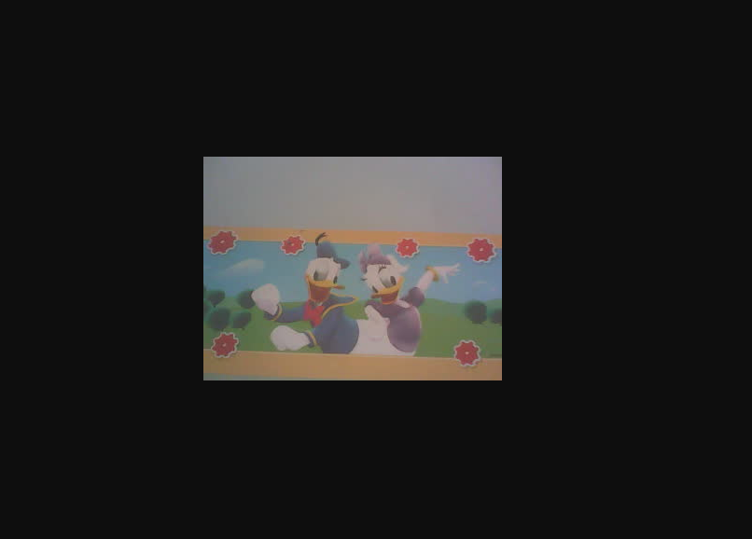
http://localhost:8080/camera.mpeg

Slide 11
mjpeg-streamer modul u Pajtonu
Instalacija:
pip install mjpeg-streamer
pa onda, recimo:
sudo apt-get install libatlas-base-dev
pa onda, recimo:
pip install -U numpy
Nakon toga, možemo da probamo da poteramo streaming preko Python aplikacije
MJPEG stream je dostupan na adresi:
http://racunar:8080/my_camera

Slide 12
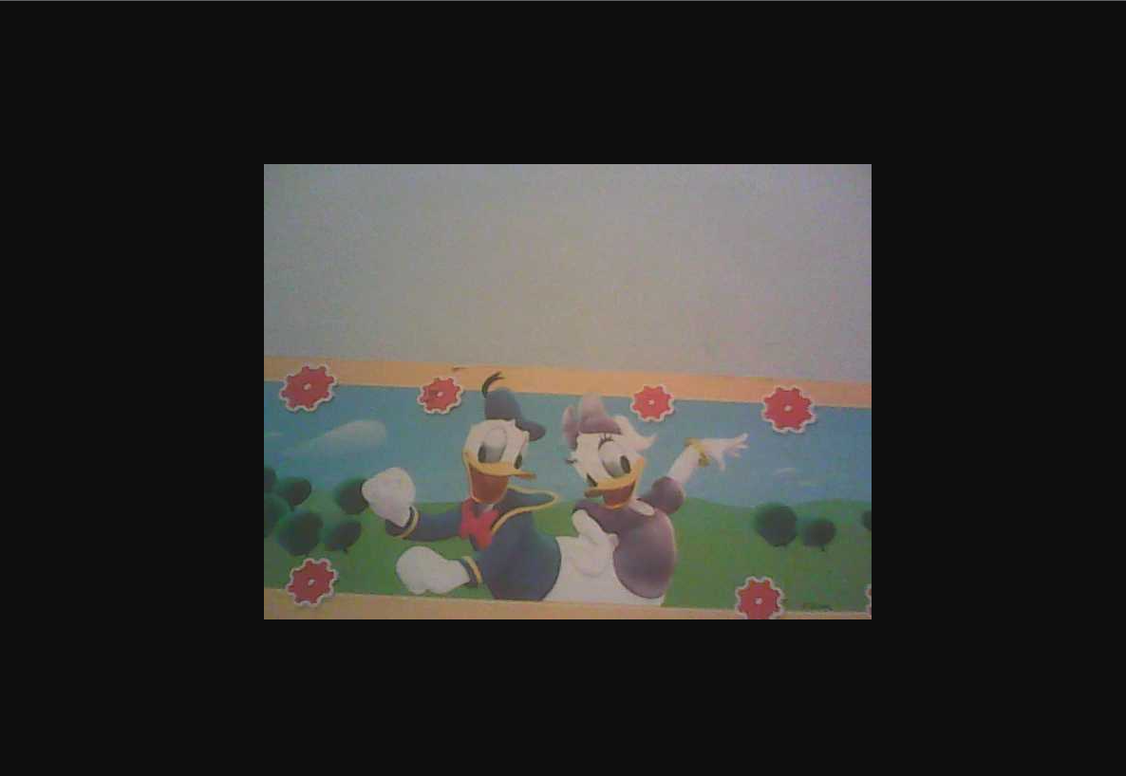
http://racunar:8080/my_camera

Slide 13
mjpeg-streamer modul u Pajtonu
import cv2
from mjpeg_streamer import MjpegServer, Stream
cap = cv2.VideoCapture(0)
stream = Stream("my_camera", size=(640, 480), quality=50, fps=30)
server = MjpegServer("pizero1.m", 8080)
server.add_stream(stream)
server.start()
while True:
_, frame = cap.read()
# cv2.imshow(stream.name, frame)
if cv2.waitKey(1) == ord("q"):
break
stream.set_frame(frame)
server.stop()
cap.release()
cv2.destroyAllWindows()

Slide 14
Motion Detection na Raspberry Pi
Jedan od najjednostavnijih programa je motion
https://motion-project.github.io/index.html
Instalacija:
sudo apt install python3-dev libcurl4-openssl-dev libssl-dev
sudo apt install motion
Instalacija će prijaviti problem sa /var/log/motion folderom – nije zapravo problem
Podesićemo log i sve ostalo u datoteci /etc/motion/motion.conf
Posle konfigurisanja ostaje samo da poteramo program:
motion –b
Pristup web interfejsu preko:
http://racunar:8081

Slide 15
Karakteristike
MJPEG HTTP Streaming
Detekcija pomeranja
Generisanje slike
Generisanje videa koji obuhvata pomeraj
Konfigurabilan
Može da se potera u background modu, da radi kao servis u pozadini

Slide 16
/etc/motion/motion.conf – bitni parametri
####################################################
# Webcontrol configuration parameters
####################################################
# Port number used for the webcontrol.
webcontrol_port 8081
# Restrict webcontrol connections to the localhost.
webcontrol_localhost off
####################################################
# Live stream configuration parameters
####################################################
# The port number for the live stream.
stream_port 8082
# Restrict stream connections to the localhost.
stream_localhost off
############################################
System control configuration parameters
###########################################
# File to write logs messages into.
log_file /home/pi/motion/motion.log
# Target directory for pictures, snapshots and movies
target_dir /home/pi/motion
# Video device (e.g. /dev/video0) to be used.
videodevice /dev/video0

Slide 17
/etc/motion/motion.conf – bitni parametri
############################################################
# Motion detection configuration parameters
############################################################
# Always save pictures and movies even if there was no motion.
emulate_motion off
# Threshold for number of changed pixels that triggers motion.
threshold 1500
# Noise threshold for the motion detection.
; noise_level 32
# Despeckle the image using (E/e)rode or (D/d)ilate or (l)abel.
despeckle_filter EedDl
# Number of images that must contain motion to trigger an event.
minimum_motion_frames 1
# Gap in seconds of no motion detected that triggers the end of an event.
event_gap 60
# The number of pre-captured (buffered) pictures from before motion.
pre_capture 3
# Number of frames to capture after motion is no longer detected.
post_capture 0

Slide 18
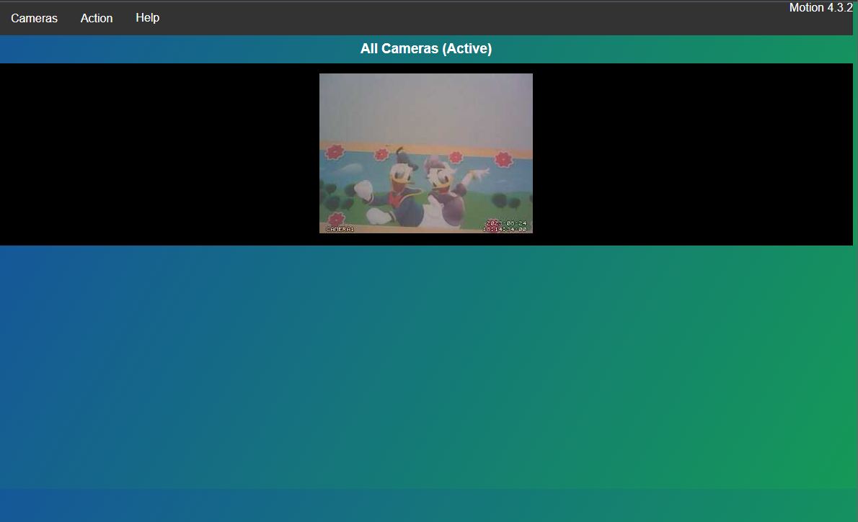
http://racunar:8081

